Slide 1
Introduction to Stored Procedures

Slide 2
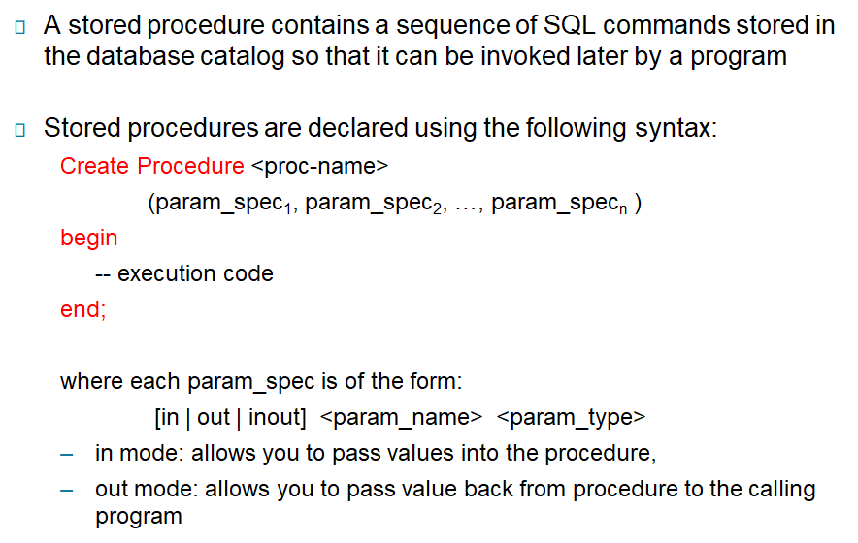
Stored Procedures
Notes:
‹#›

Slide 3
Executing PL/SQL
Change the delimiter (i.e., terminating character) of SQL statement from semicolon (;) to something else (e.g., //),so that you can distinguish between the semicolon of the SQL statements in the procedure and the terminating character of the procedure definition
To execute a procedure, we can save it in a .sql file and run it in MYSQL.
Notes:
‹#›

Slide 4
Variables and Types
Type
One of the types used by SQL for database columns
A generic type used in PL/SQL such as INT
Declared to be the same as the type of some database column
E.G.
DECLARE
price INT;
myBeer TEXT;
Notes:
‹#›

Slide 5
Simple Procedure
Plain SQL
CREATE TABLE T1(
e INTEGER,
f INTEGER
);
DELETE FROM T1;
INSERT INTO T1 VALUES(1, 3);
INSERT INTO T1 VALUES(2, 4);
T1
e
f
1
3
2
4
Notes:
‹#›

Slide 6
Simple Procedure
T1
Stored Procedure
delimiter //
Create Procedure proc()
Begin
Declare a INT;
Decalre b INT;
SELECT e,f INTO a,b FROM T1 WHERE e>1;
INSERT INTO T1 VALUES(b,a);
END;
//
e
f
1
3
2
4
4
2
Notes:
‹#›

Slide 7
Control Flow in Procedures
IF statement
IF <condition_1> THEN ...
ELSEIF <condition_2> THEN ...
... ...
ELSEIF <condition_n> THEN ...
ELSE ...
END IF;
Notes:
‹#›

Slide 8
Control Flow in Procedures
E.g.
BEGIN
DECLARE a NUMBER;
DECLARE b NUMBER;
SELECT e,f INTO a, b FROM T1 WHERE e>1;
IF b=1 THEN
INSERT INTO T1 VALUES(b, a);
ELSE
INSERT INTO T1 VALUES(b+10, a+10);
END IF;
END;
Notes:
‹#›

Slide 9
Control Flow in Procedures
Loops :
LOOPNAME:LOOP
<loop_body> /* A list of statements. */
END LOOP LOOPNAME;
EXIT
EXIT WHEN <condition>;
Notes:
‹#›

Slide 10
E.G.
BEGIN
DECLARE i INT DEFAULT 1;
ITR:LOOP
INSERT INTO T1 VALUES(i, i);
SET i = i+1;
EXIT WHEN i>100;
END LOOP ITR;
END;
Notes:
‹#›

Slide 11
Control Flow in PL/SQL
WHILE loop
WHILE <condition>
<loop_body>
END;
Notes:
‹#›

Slide 12
Cursors
Definition
DECLARE CURSOR T1Cursor FOR
SELECT e, f
FROM T1
WHERE e < f;
Notes:
‹#›

Slide 13
BEGIN
DECLARE a INT;
DECLARE b INT;
DECLARE CONTINUE HANDLER FOR NOT FOUND SET noMoreRows = 0;
OPEN T1Cursor;
ITR:LOOP
/* Retrieve each row of the result of the above query
into PL/SQL variables: */
FETCH T1Cursor INTO a, b;
/* If there are no more rows to fetch, exit the loop: */
IF noMoreRows = 0 THEN
LEAVE ITR;
/* Insert the reverse tuple: */
INSERT INTO T1 VALUES(b, a);
END LOOP ITR;
/* Free cursor used by the query. */
CLOSE T1Cursor;
END;
.
run;
Notes:
‹#›

Slide 14
BEGIN
DECLARE CURSOR my_cursor FOR
SELECT wages, ename
FROM emp;
DECLARE my_wage INT;
DECLARE my_name TEXT;
DECLARE CONTINUE HANDLER FOR NOT FOUND SET noMoreRows = 0;
OPEN my_cursor;
ITR:LOOP
FETCH my_cursor INTO my_wage,my_name;
IF noMoreRows = 0 THEN
LEAVE ITR;
IF my_wage > 2000 THEN
INSERT INTO temp VALUES (NULL, mywage,
my_name);
END IF;
END LOOP ITR;
CLOSE my_cursor;
END;
//
Notes:
‹#›

Slide 15
BEGIN
DECLARE CURSOR num1_cur FOR SELECT num FROM num1_tab
ORDER BY sequence;
DECLARE CURSOR num2_cur FOR SELECT num FROM num2_tab
ORDER BY sequence;
DECLARE num1 INT;
DECLARE num2 INT;
DECLARE pair_num INT;
SET pair_num=0;
DECLARE CONTINUE HANDLER FOR NOT FOUND SET noMoreRow = 0;
OPEN num1_cur;
OPEN num2_cur;
ITR:LOOP -- loop through the two tables and get
-- pairs of numbers
FETCH num1_cur INTO num1;
FETCH num2_cur INTO num2;
IF noMoreRow = 0 THEN
LEAVE ITR;
SET pair_num = pair_num + 1;
INSERT INTO sum_tab VALUES (pair_num, num1 + num2);
END LOOP ITR;
CLOSE num1_cur;
CLOSE num2_cur;
END;
//
Notes:
‹#›

Slide 16
BEGIN
DECLARE CURSOR c1 FOR
SELECT ename, empno, sal FROM emp
ORDER BY sal DESC; -- start with highest-paid employee
DECLARE my_ename CHAR(10);
DECLARE my_empno NUMBER(4);
DECLARE my_sal NUMBER(7,2);
DECLARE CONTINUE HANDLER FOR NOT FOUND SET noMoreRow = 0;
OPEN c1;
ITR:LOOP
FETCH c1 INTO my_ename, my_empno, my_sal;
IF noMoreRow = 0 THEN
LEAVE ITR;
INSERT INTO temp VALUES (my_sal, my_empno, my_ename);
COMMIT;
END LOOP ITR;
CLOSE c1;
END;
Notes:
‹#›

Slide 17
BEGIN
DECLARE num1 INT; -- Declare variables
DECLARE num2 INT; -- to be of same type as
DECLARE num3 INT; -- database columns
DECLARE result INT;
DECLARE CONTINUE HANDLER FOR NOT FOUND SET noMoreRow = 0;
DECLARE CURSOR c1 FOR
SELECT n1, n2, n3 FROM data_table
WHERE exper_num = 1;
OPEN c1;
ITR:LOOP
FETCH c1 INTO num1, num2, num3;
IF noMoreRow = 0 THEN
LEAVE ITR;
/* calculate and store the results */
SET result = num2/(num1 + num3);
INSERT INTO temp VALUES (result, NULL, NULL);
END LOOP ITR;
CLOSE c1;
COMMIT;
END;
Notes:
‹#›

Slide 18
Stored Procedures
PL/SQL code stored in the database and executed when called by the user.
Called by procedure name from another PL/SQL block or using EXECUTE from SQL+. For example EXEC SQR(50)
Example:
Create procedure SQR (IN v_num_to_square INT)
BEGIN
DECLARE v_answer number;
SET v_answer = v_num_to_square * v_num_to_square;
Select v_answer;
END;
//
Notes:
‹#›

Slide 19
Function
User defined function stored in the database and executed when a function call is made in code: example x := SQUARED(50)
Example:
Create Function SQUARED
(IN p_number_to_square INT)
RETURNS INT
BEGIN
DECLARE v_answer INT;
SET v_answer = p_number_to_square * p_number_to_square;
RETURN v_answer;
END;
/
Notes:
‹#›

